Slide 1

Seminar 7
UBIQUITOUS SENSOR NETWORK LABORATORY
Department of Electronics Engineering, Keimyung University
23th June 2016
By Tran Viet Cuong

Slide 2
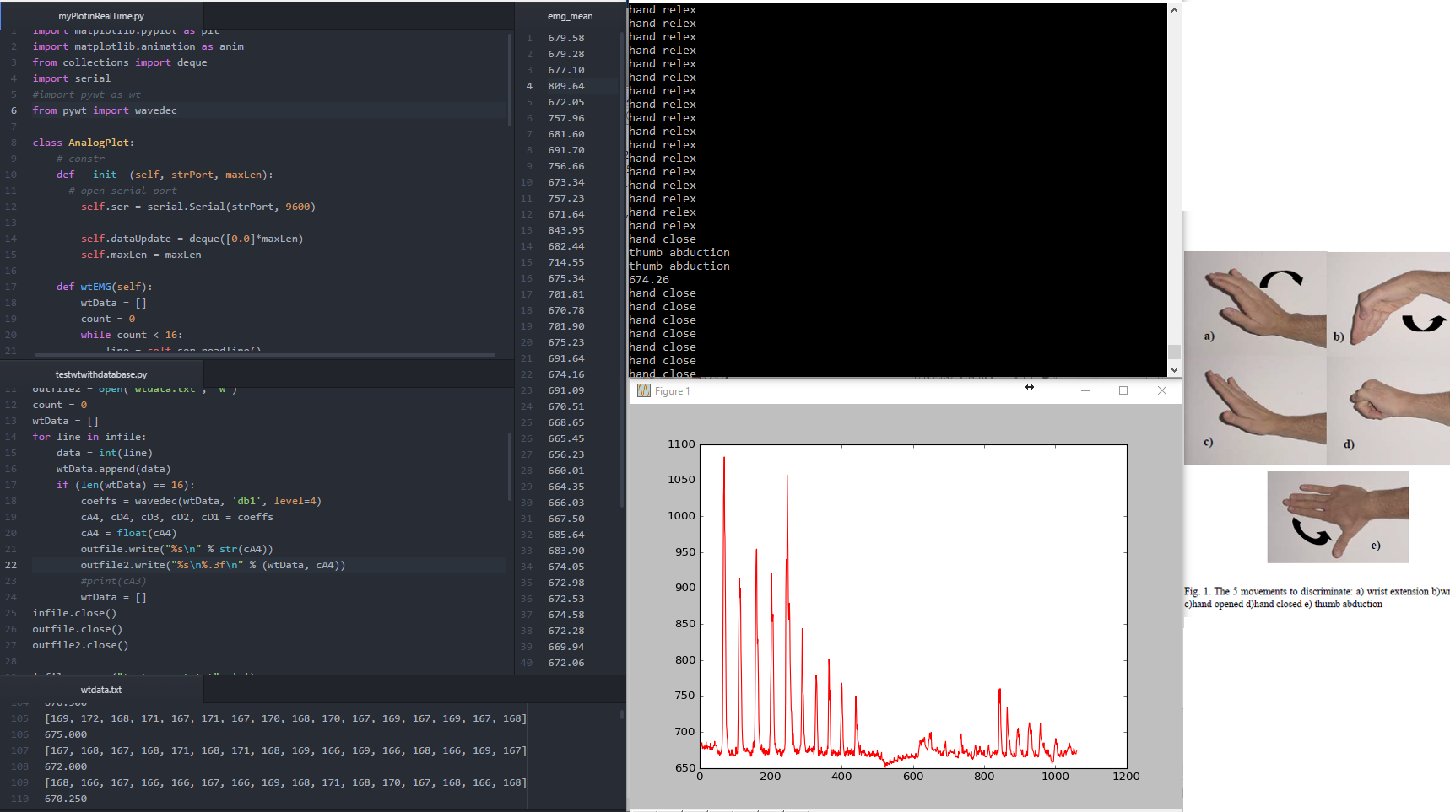
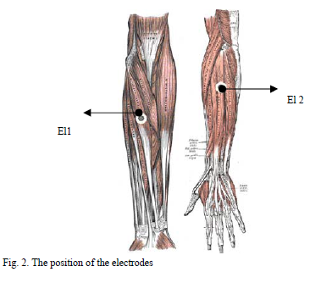

Slide 3
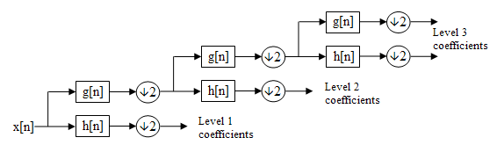
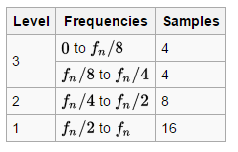
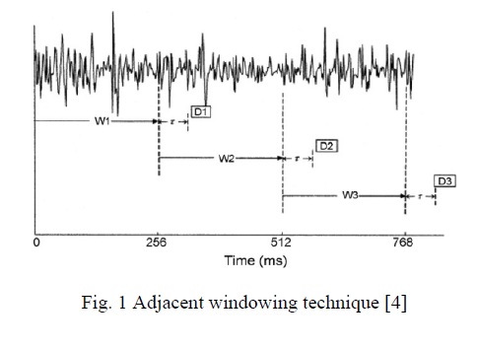
A 3 level filter bank of DWT
Problem about accuracy:
For 16 samples, EMG signal values, having 1 value for cA (apprx. Coefficient) at level 4.
For example 256 samples of EMG signal then after DWT at level 4, we just only have 16 samples.

Slide 4
The most important things:
How to use features to classify patterns for more accurate?
What is relationship between emotion states and bio-signal (muscle, heart beat, …)?

Slide 5
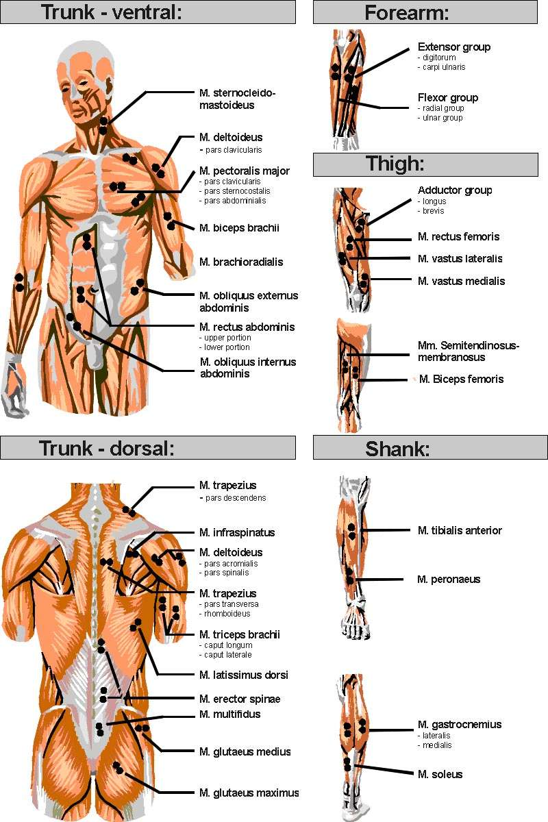
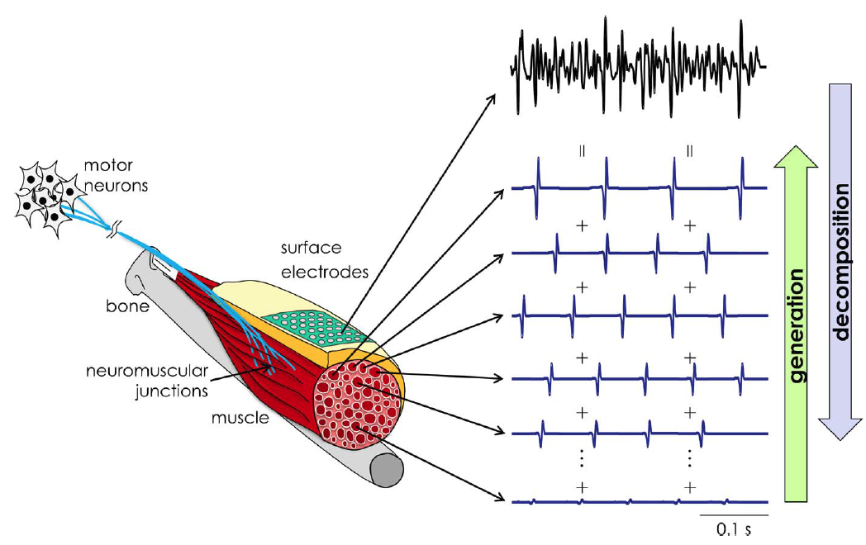
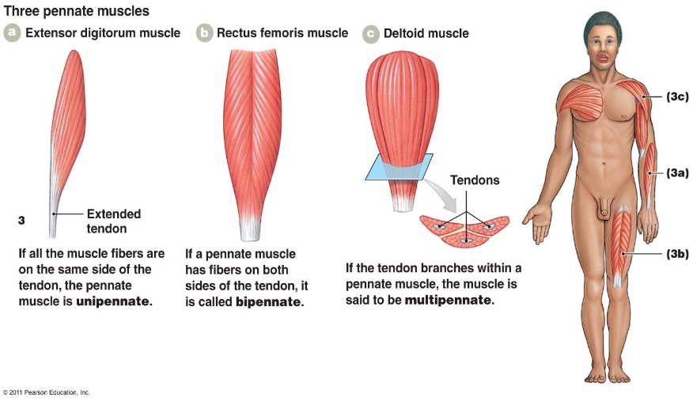
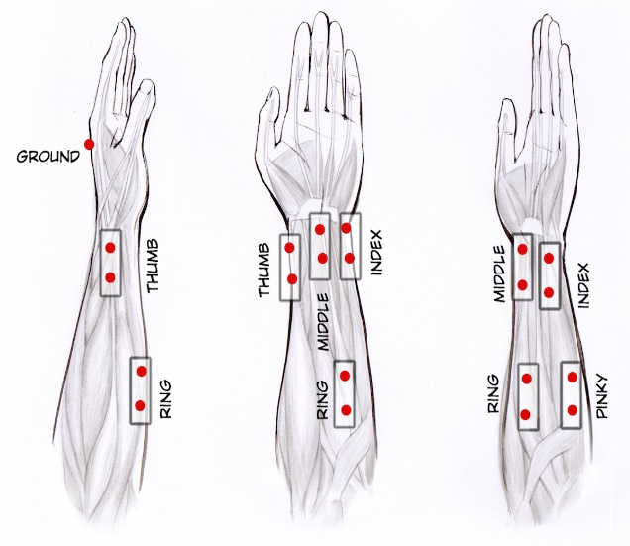
Location of Electrodes in Surface EMG
Identification of the direction of muscle fibers: Electrodes must align with that of muscle fibers.
Attaching the reference electrode on electrically neutral tissue such as bony prominence
Electrodes should be located near the muscle belly, after considering the moving Innervation Zone (IZ) recording
However, in muscles with irregularly oriented muscle fibers, such as pennate muscle, the proper direction of electrodes could be not determined.

Slide 6
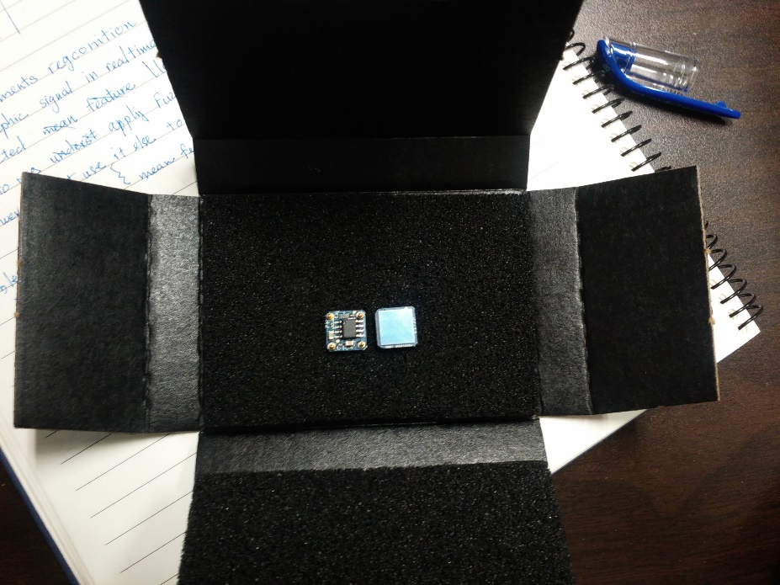
in next 2 weeks
ECG sensor
DRL circuit (Driven right leg circuit)
ECG Feature Extraction
UBIQUITOUS SENSOR NETWORK LABORATORY

Slide 7
Reference
[1] Location of Electrodes in Surface EMG (Ken Nishihara and Takuya Isho)
[2] https://backyardbrains.com/experiments/RobotHand
[3] http://health.uottawa.ca/biomech/courses/apa4311/applications.html [4]
[4] http://josephmr.com/realtime-arduino-sensor-monitoring-with-matplotlib/
[5] https://en.wikipedia.org/wiki/Discrete_wavelet_transform
UBIQUITOUS SENSOR NETWORK LABORATORY

Slide 8
Any Questions ?
UBIQUITOUS SENSOR NETWORK LABORATORY

Slide 9
THANK YOU!
UBIQUITOUS SENSOR NETWORK LABORATORY

